Slide 1
Movie analysis
Project On :

Slide 2
OBJECTIVE
The objective of this SQL project is to perform in-depth analysis and exploration of a movie dataset to extract meaningful insights into various aspects of the movie industry. The analysis aims to uncover trends, patterns, and correlations within the dataset, providing valuable information for stakeholder.

Slide 3
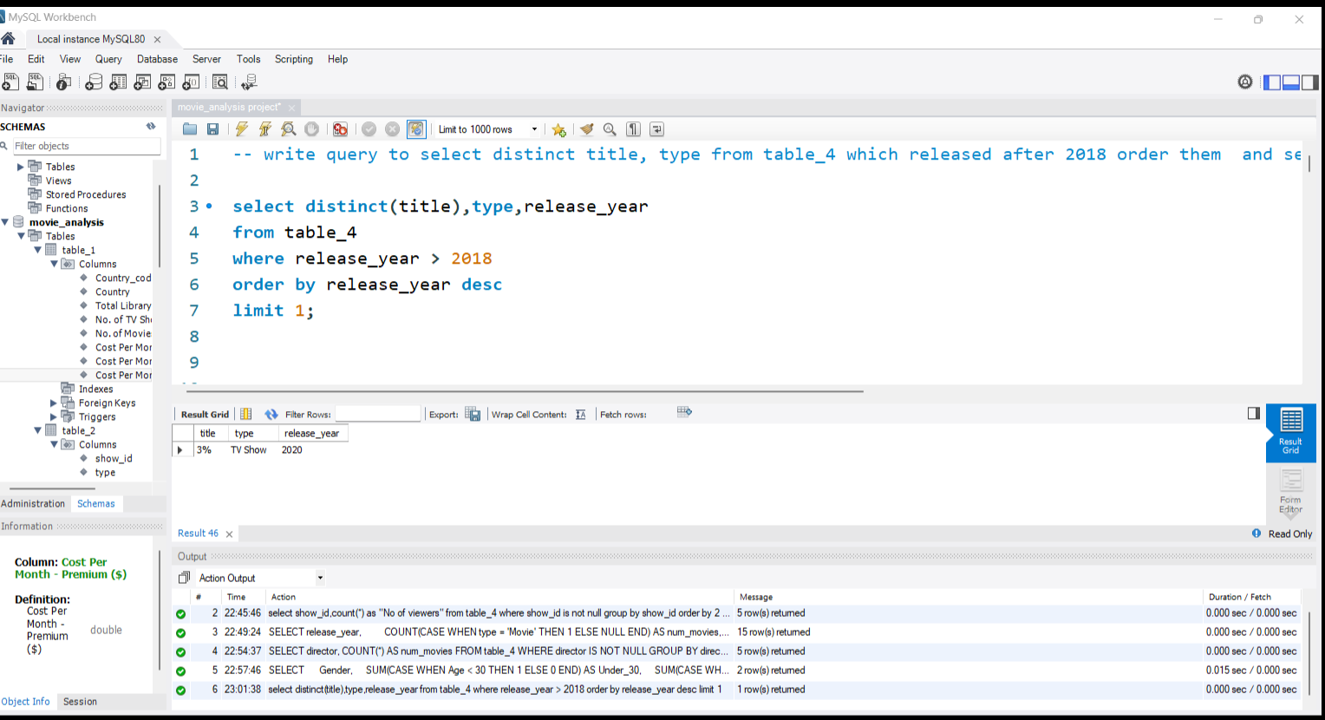
write query to select distinct title, type from table_4 which released after 2018 order them and select latest year of movie released.

Slide 4
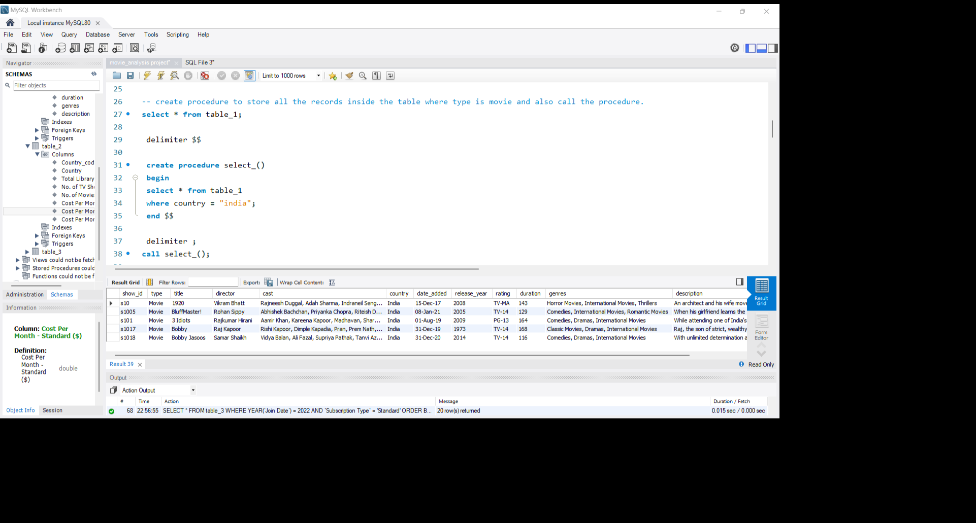
create procedure to store all the records inside the table where type is movie and also call the procedure.

Slide 5
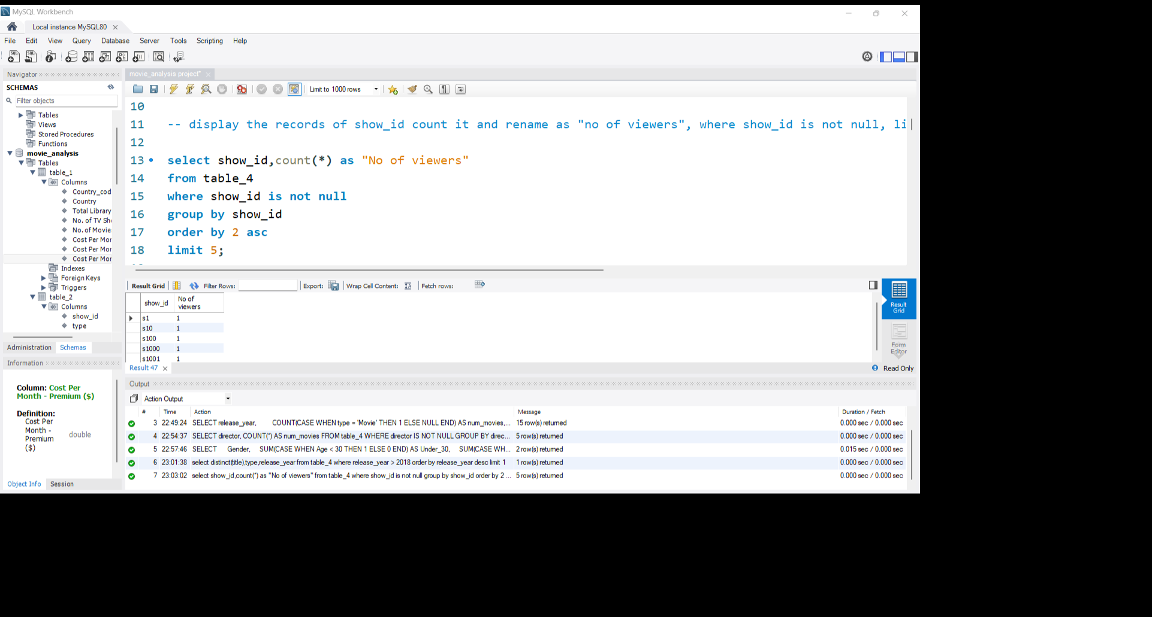
Display the records of show id count it and rename as "no of viewers", where show id is not null, limit them 5 .

Slide 6
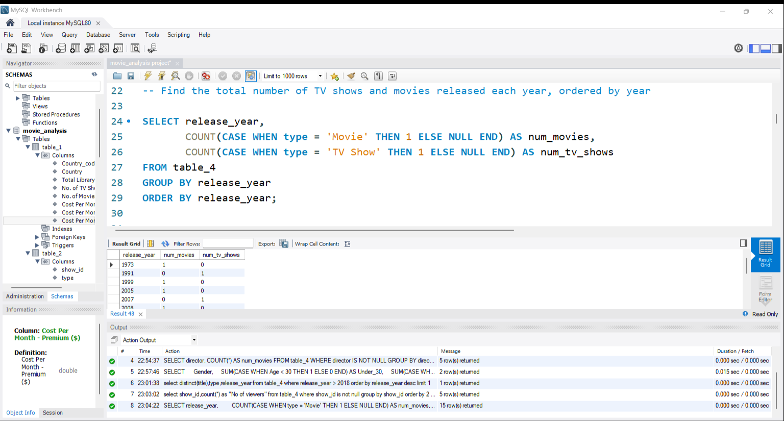
Find the total number of TV shows and movies released each year, ordered by year.

Slide 7
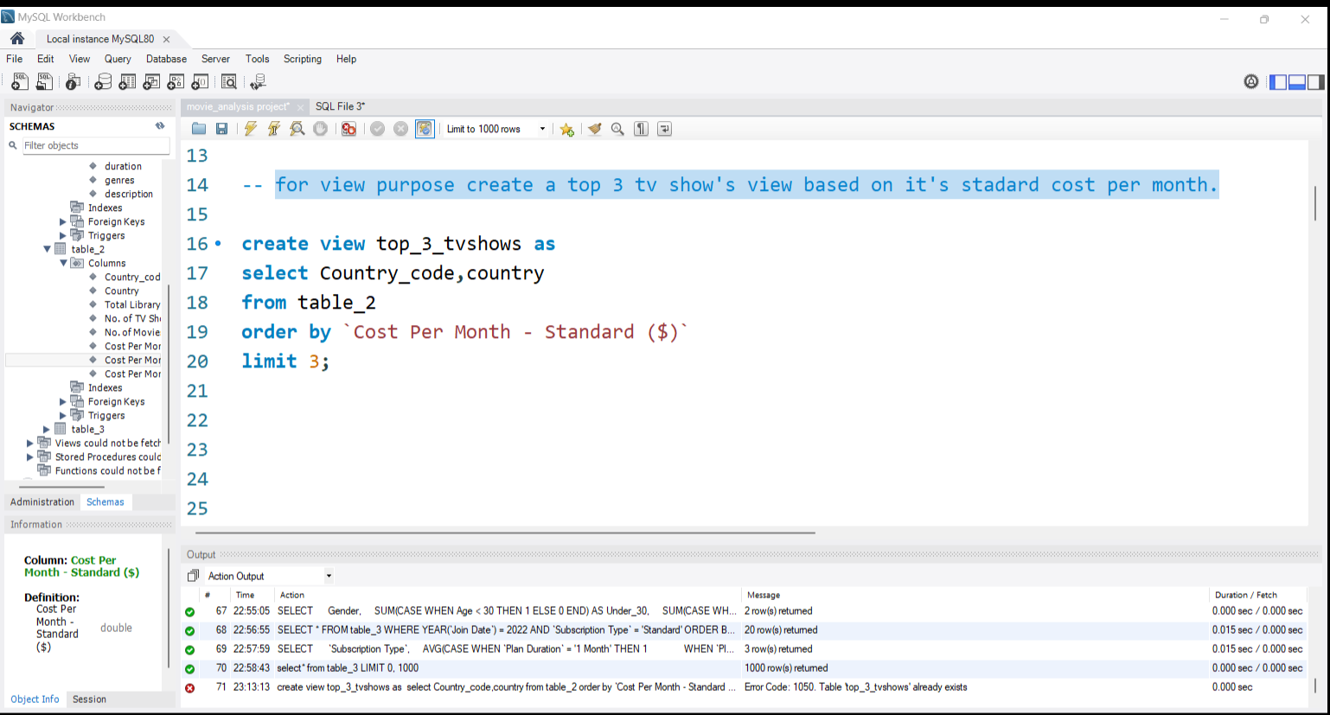
for view purpose create a top 3 tv show's view based on it's staNdard cost per month.

Slide 8
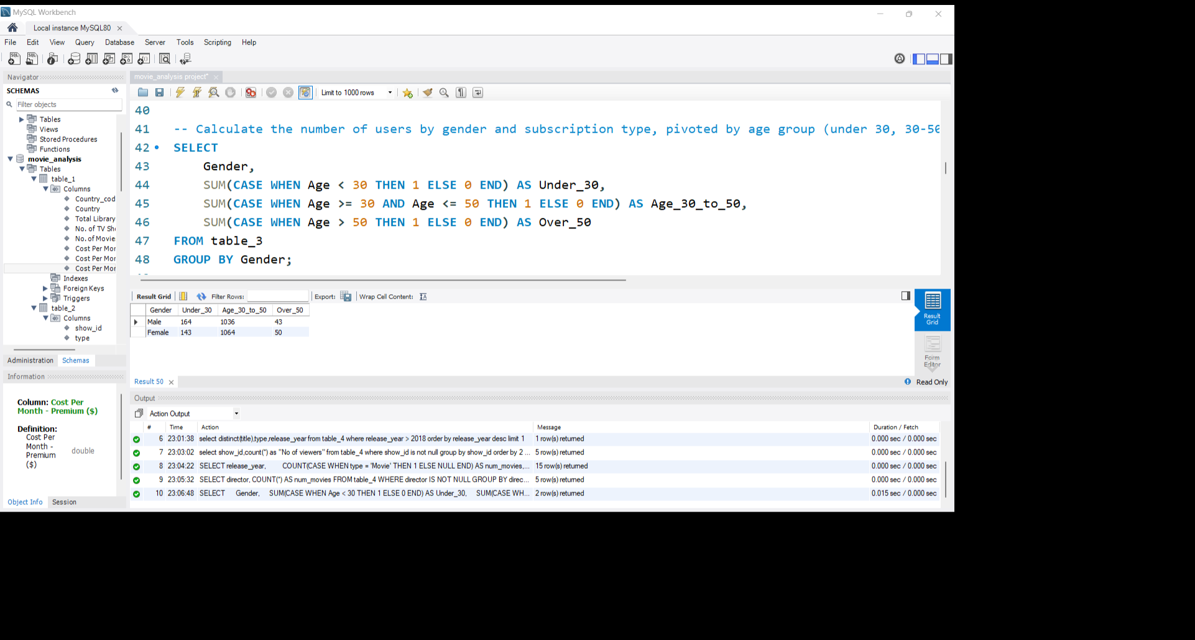
Calculate the number of users by gender and subscription type, pivoted by age group (under 30, 30-50, over 50).

Slide 9
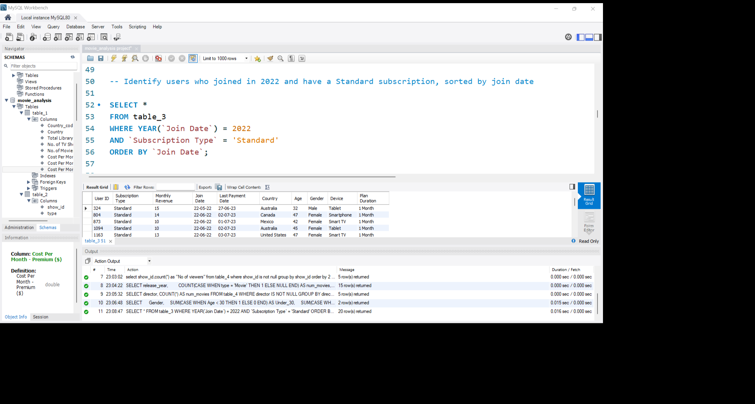
Identify users who joined in 2022 and have a Standard subscription, sorted by join date.

Slide 10
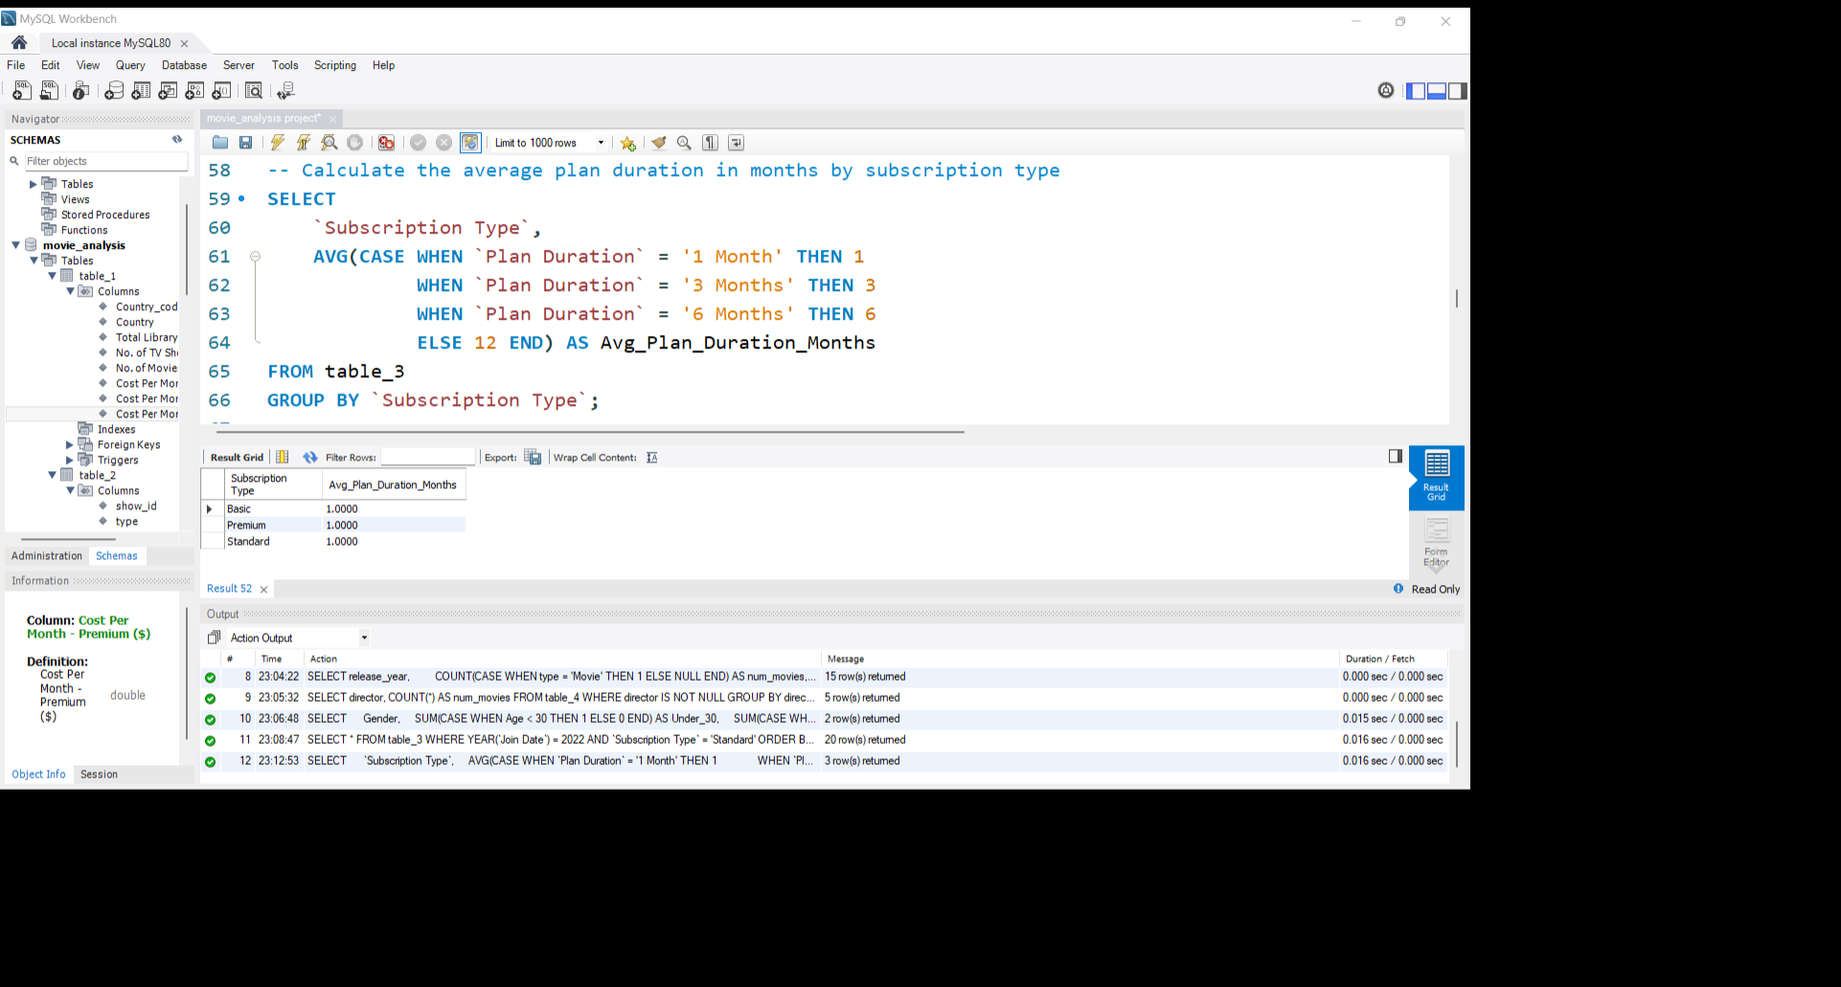
Calculate the average plan duration in months by subscription type.

Slide 11
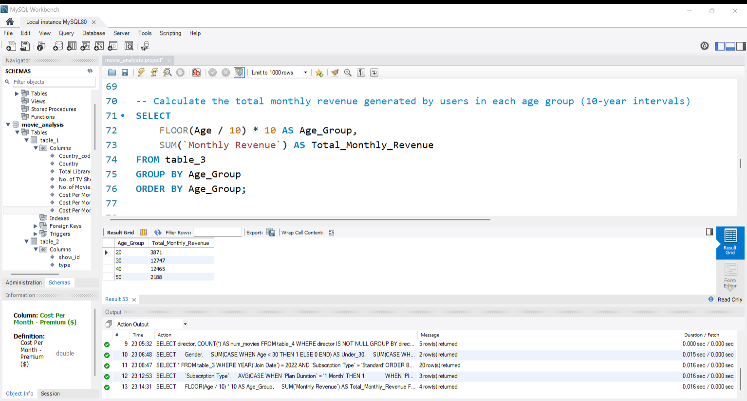
Calculate the total monthly revenue generated by users in each age group (10-year intervals).

Slide 12
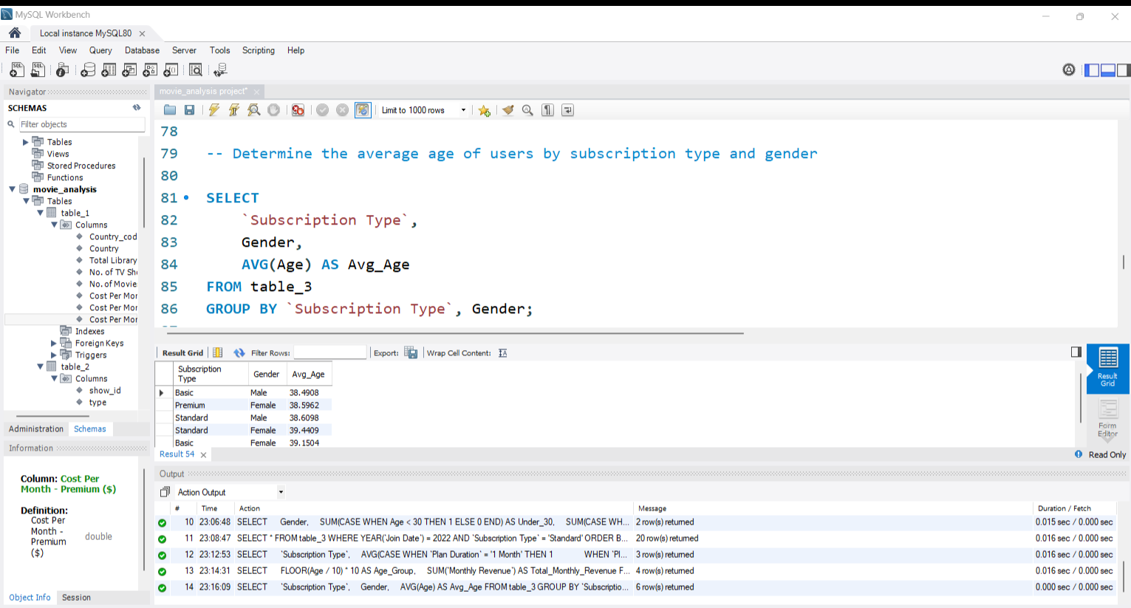
Determine the average age of users by subscription type and gender.

Slide 13
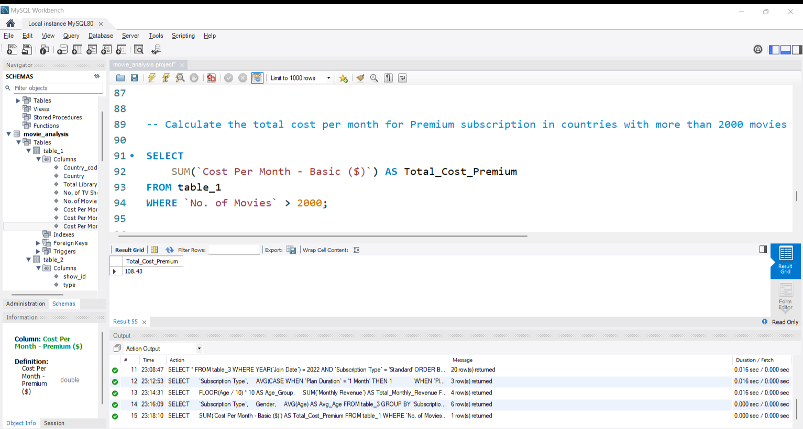
Calculate the total cost per month for Premium subscription in countries with more than 2000 movies.

Slide 14
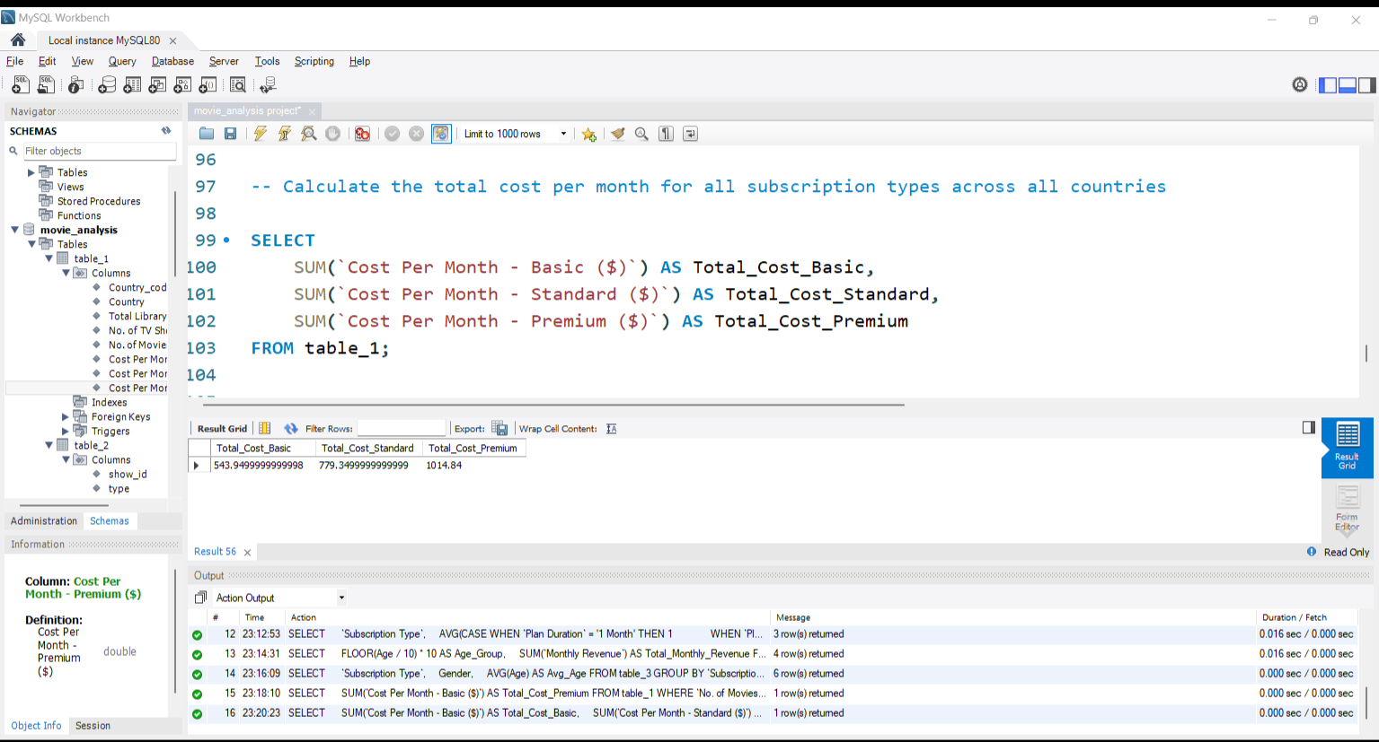
Calculate the total cost per month for all subscription types across all countries.

Slide 15
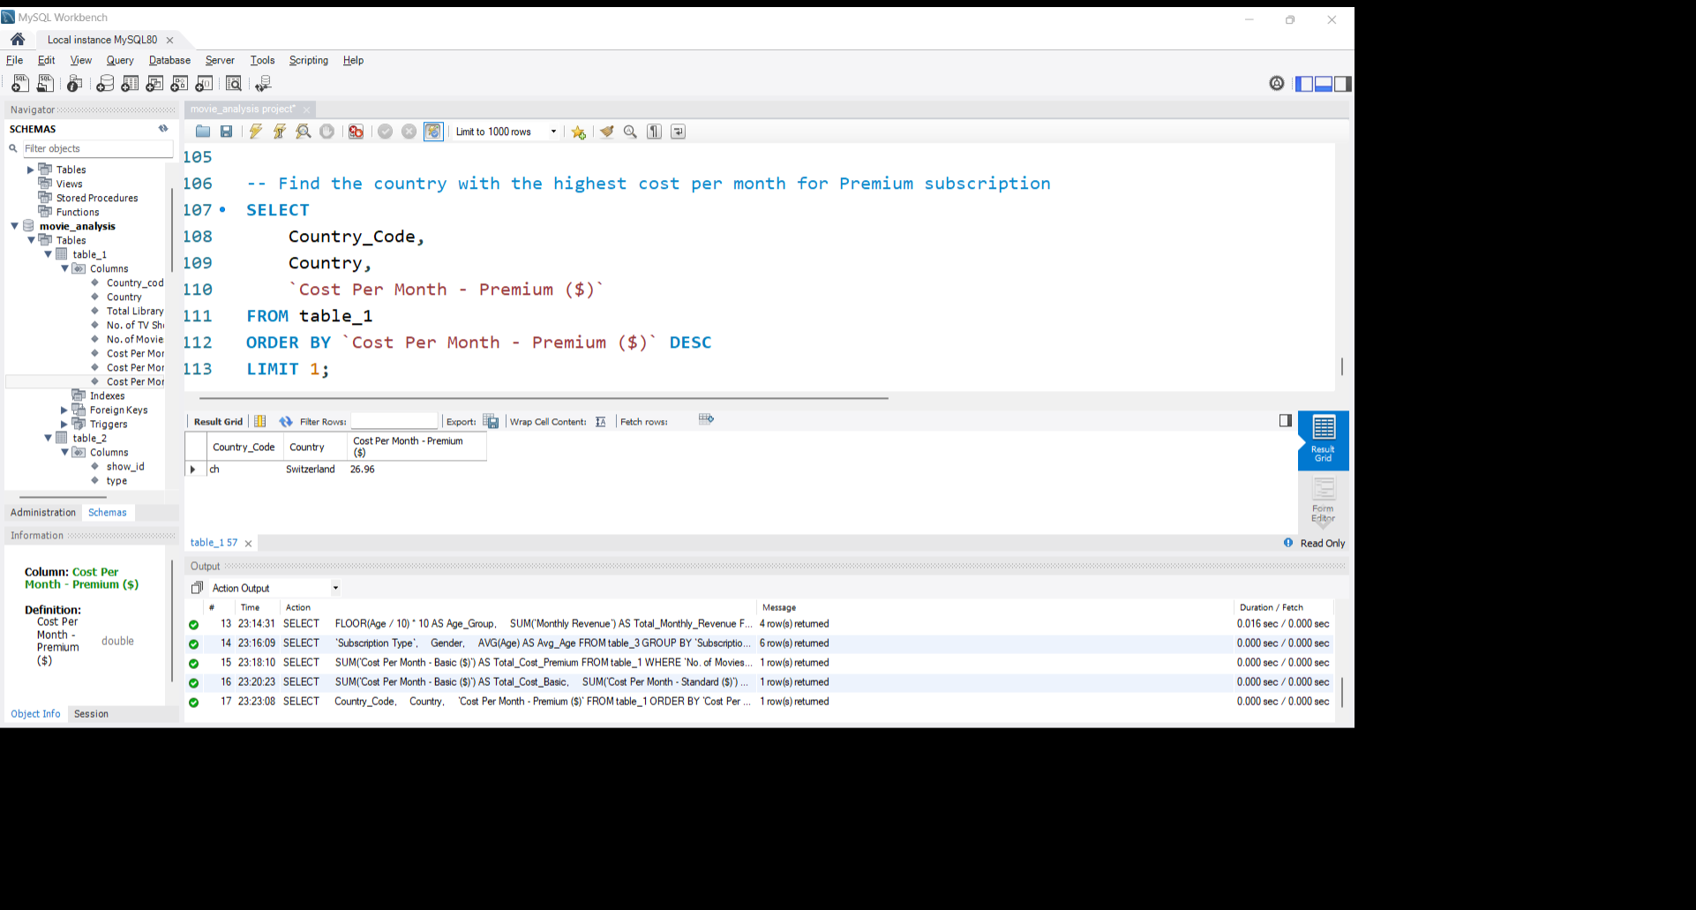
Find the country with the highest cost per month for Premium subscription.

Slide 16
THANK YOU !

